Slide 1


Welcome Future Graduate!
Florida Vocational Institute’s New Student Orientation

Slide 2

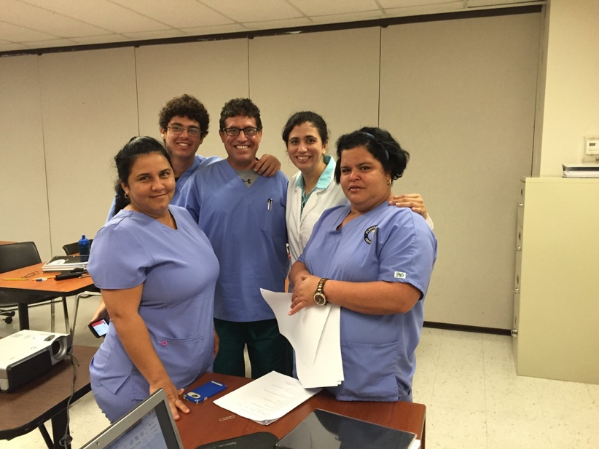
Agenda
New Student Orientation
1
Meet the FVI Team
2
What Are Your Goals
3
Program Overview
4
Classroom Expectations
5
Classroom Expectations / Standards of Conduct
6
Substance Abuse / Drug Screening
7
Applying for a Certification Examination

Slide 3

Meet the FVI Team
Administration
Campus Vice President-Denyse Antunes
Allied Health Program Director– Jorge Gomez
Student Support Team
Director of Admissions - Gretel Chong
Business Office Manager – Luisa Enriquez
Financial Aid Administrator- Eliezer Tabares
Registrar- Lidia Bravo
Director of Career Services- Andrea Holguin-Reyes
Helping Students Achieve Success

Slide 4


Agenda
New Student Orientation
1
Meet the FVI Team
2
What Are Your Goals
3
Program Overview
4
Classroom Expectations / Standards of Conduct
5
Externship Expectations
6
Substance Abuse / Drug Screening
7
Applying for a Certification Examination

Slide 5










What Are Your Goals
1
2
3
4
Take Certific-ation Exam
5
First day
Of School
Complete
Courses
GRADUATION!
Externship
6
Begin your Career as a Nationally Registered Allied Health Professional and
start living the life you always wanted!
Helping Students Achieve Success

Slide 6


Agenda
New Student Orientation
1
Meet The FVI Team
2
What Are Your Goals
3
Program Overview
4
Classroom Expectations / Standards of Conduct
5
Externship Expectations
6
Substance Abuse / Drug Screening
7
Applying for a Certification Examination
Helping Students Achieve Success

Slide 7
Program Overview
Program and Course Description (School Catalog)
Program Mission and Outcomes
Grading Policy (School Catalog)
Attendance Policy (School Catalog)
Student Conduct/Expectations (School Catalog)
Grievance Procedure (School Catalog)

Slide 8
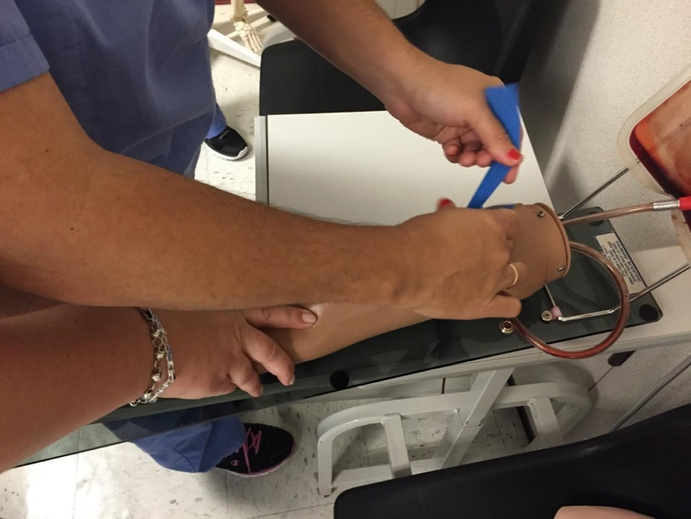
Agenda
New Student Orientation
1
Meet the FVI Team
2
What Are Your Goals
3
Program Overview
4
Classroom Expectations / Standards of Conduct
5
Externship Expectations
6
Substance Abuse / Drug Screening
7
Applying for a Certification Examination

Slide 9

Classroom Expectations / Standards of Conduct
Attend classes every day AM: Mo-Th: 8:30a-1:30p and Mo-Th: 5:30p-10:30p
Prepare for class and arrive on time
Dress in clinical attire
No food in classrooms. Drinks with a lid are permitted.
Respectful behavior, and all electronic devices should be turn off.
Obligation to act as responsible members of the FVI community
Behavior that discredits student or the School may lead to disciplinary action, suspension, and/or dismissal.
Helping Students Achieve Success

Slide 10
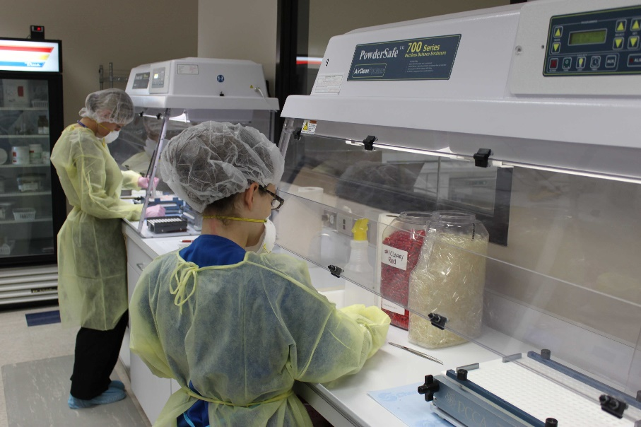

Agenda
New Student Orientation
1
Meet the FVI Team
2
What Are Your Goals
3
Program Overview
4
Classroom Expectations / Standards of Conduct
5
Externship Expectations
6
Substance Abuse / Drug Screening
7
Applying for NHAP or PTCB Certification Examination

Slide 11

Externship Expectations
Externship Policy (School Catalog)
PCT- 60 hours (3 weeks)
MA- 120 hours (6 weeks)
PHT-200 Hours (10 weeks)
Dress Code
Expected Behavior: Respect ----Professionalism-- Cooperation
Most externship assignments are Monday through Friday from 8a-6pm with limited externships offered in the evening or weekends. Please plan in advance.
Helping Students Achieve Success

Slide 12
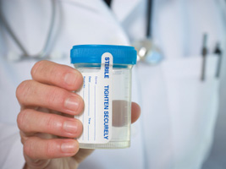

Agenda
New Student Orientation
1
Meet the FVI Team
2
What Are Your Goals
3
Program Overview
4
Classroom Expectations / Standards of Conduct
5
Externship Expectations
6
Substance Abuse / Drug Screening
7
Applying for NHAP or PTCB Certification Examination

Slide 13

Substance Abuse / Drug Screening
Drug and Alcohol Policy ( School Catalog )
Mandatory testing as part of the externship for Pharmacy Technician.
May be requested with evidence of behavioral indicates of prohibited substance use.
Will lead to immediate action
Helping Students Achieve Success

Slide 14
Learning Resource/Media Center
LRC/Media Center is located in the back right corner of the campus
Hours of Operation
Monday –Thursday 9a-7p
Friday 9a-4p
Textbooks and resource materials are available for use in the center.
Computers are available for student use
Please see your instructor or Program Director for orientation and questions.
Useful Apps:
Duolingo
Dropbox
Google Translator
Dictionary.com
Quizlet

Slide 15



Agenda
New Student Orientation
1
Meet the FVI Team
2
What Are Your Goals
3
Program Overview
4
Classroom Expectations / Standards of Conduct
5
Externship Expectations
6
Substance Abuse / Drug Screening
7
Applying for NHAP or PTCB Certification Examination

Slide 16

Applying for Certification Examination
Process for application completion just before graduation.
Pharmacy Technicians complete a registration application with the Board of Pharmacy (Florida Registration). In addition, complete a license application with the PTCB for National Certification. All students file with Pearson for PTCE testing
Medical Assistants and Patient Care Technicians will complete a certification exam application with the National Association of Healthcare Professionals to take the Nationally Registered Certified Patient Care Technician (NRCPCT) exam or National Registered Certified (NRCMA) exam for Medical Assistants. Visit: www.nahpusa.com for additional certification information.
Helping Student Achieve Success

Slide 17

FVI PARKING
Between the hours of 8:00 AM to 5:00 PM any car parked in New Horizons/ FVI spot without permit will be towed.
Thank you.

Slide 18
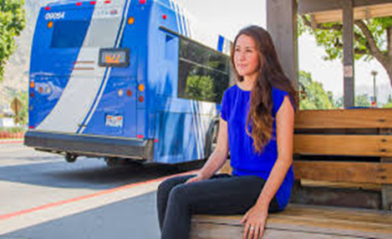

STUDENT MONTHLY BUS PASSES AVAILABLE
BUS PASS REQUESTS
MUST BE PAID BY THE 2ND WEEK OF THE MONTH FOR UPCOMING MONTH
SEE THE BUSINESS OFFICE
COST $56.25 (must be paid cash)
MUST HAVE STUDENT ID AT ALL TIMES WHEN RIDING THE BUS

Slide 19
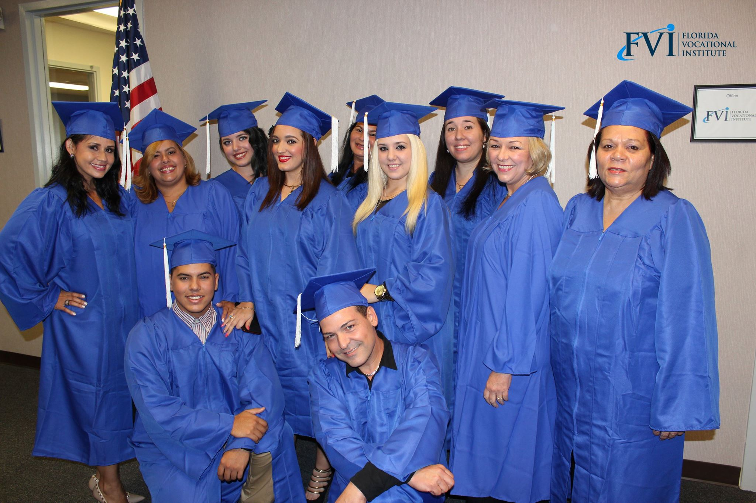
Your Journey Starts Now!

